Slide 1
Red Rock Resorts
Long RRR 4.5% 2028
Ryan Finegan

Slide 2
Table of Contents
3. RRR Rundown
4. Relative Value
5. Ex-Durango
6. Credit Structure
7-16. Graphs
17. Encouraging Schedule

Slide 3
Relative Value
Asset Protection
Owns all properties
Possible M&A Company given size and assets
Good Liquidity
Cash: ~$120mn
Net Leverage: ~$4.3x
Net Leverage Target: management stated ~3x (after Durango)
Positive ‘24 FCF outlook after Durango
4Q21 sale of Palms left it more focused on Gaming Revenues
FY22: Gaming accounted for nearly 70% of top-line
Durango (delayed now until Dec. 5)
Enhances non-casino sales

Slide 4
Relative Value

Slide 5
Ex-Durango
Durango had a total cost of $780mn
You can see the CAPEX numbers of the recent Quarters
Page 14 (Comps sequential CAPEX quarterly)
Page 15 (Comps sequential CAPEX to Revenue quarterly)
Page 16 (Comps sequential CFFO to CAPEX quarterly)
All 3 pages show the large capital spend of CAPEX that Durango required
CAPEX for FY24 Cons. is at ~80mn
FCF should turn meaningfully positive post-Durango

Slide 6
Debt Structure

Slide 7
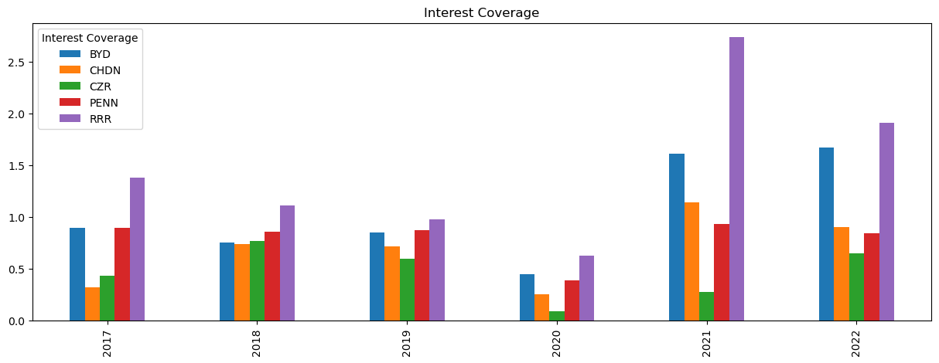
Interest Coverage

Slide 8
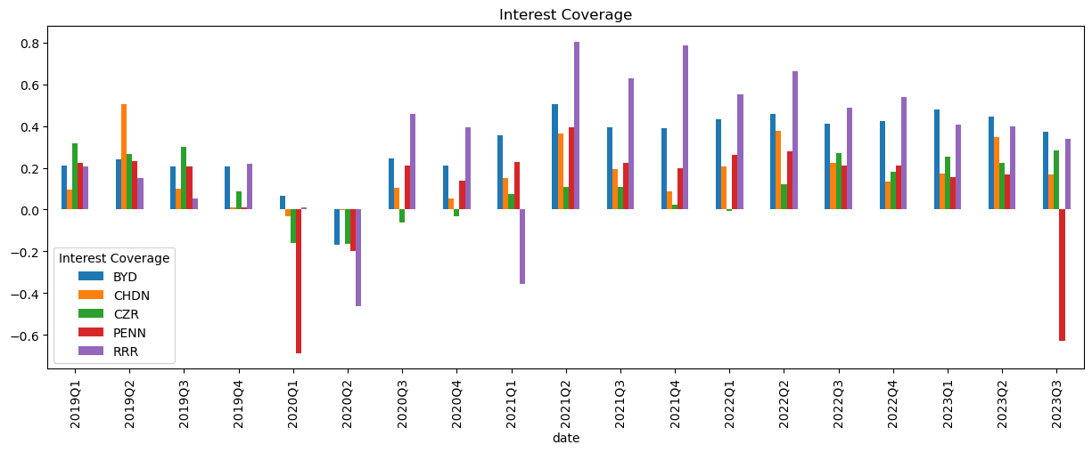
Interest Coverage (quarterly)

Slide 9
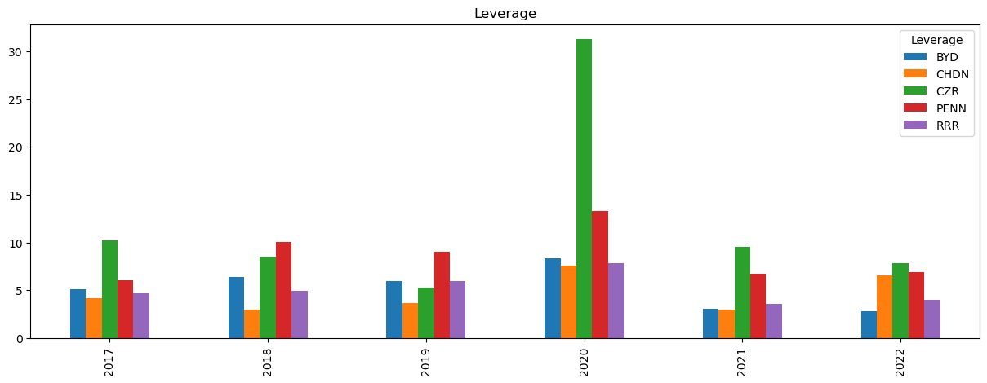
Net Leverage

Slide 10
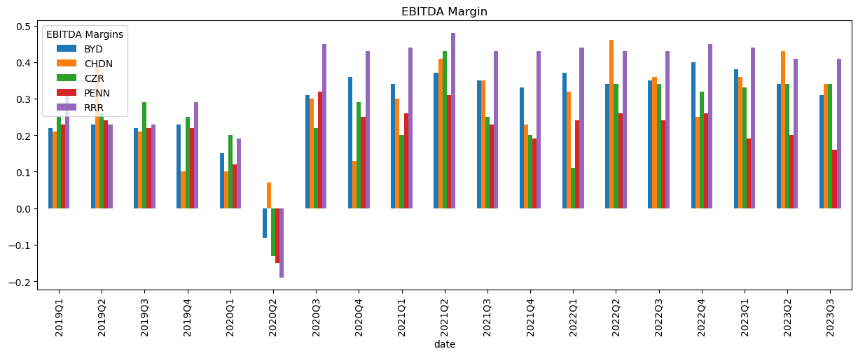
EBITDA Margin (sequential)

Slide 11
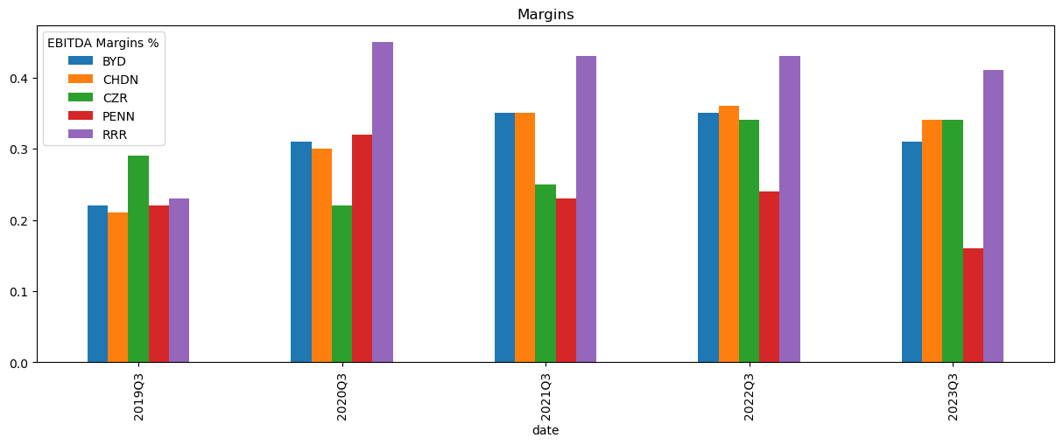
EBITDA Margin (3Q y/y)

Slide 12
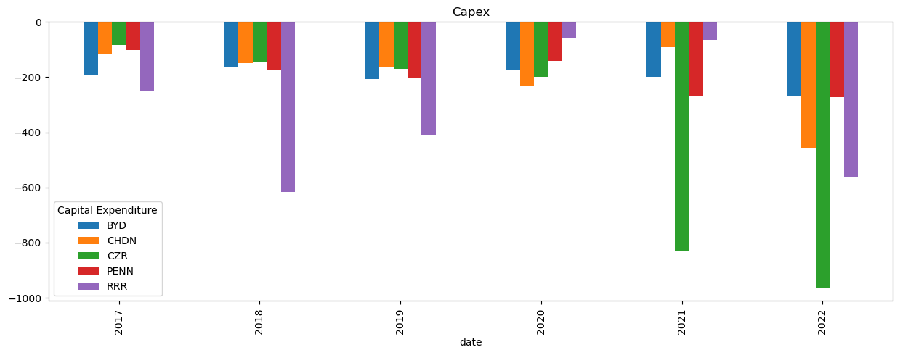
CAPEX (Annually)

Slide 13
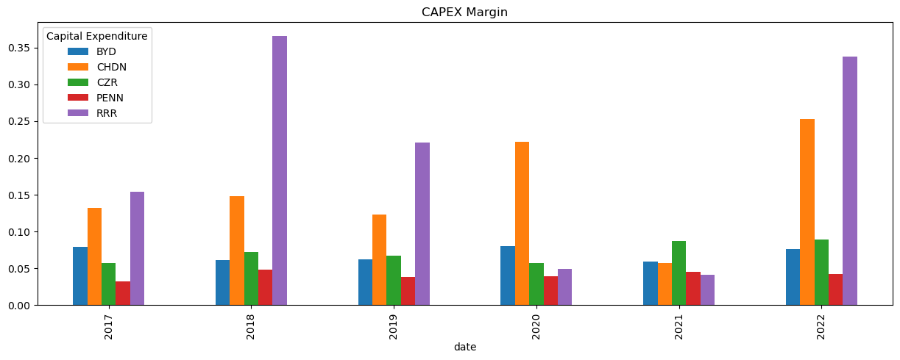
CAPEX Margin (Annually)

Slide 14
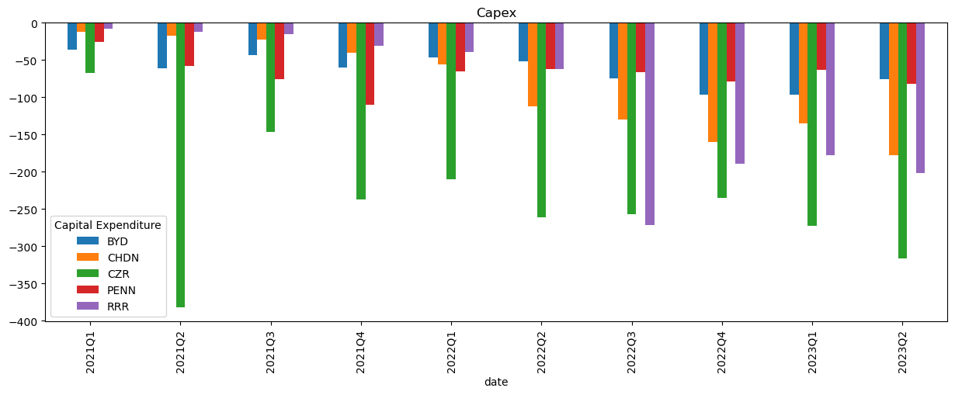
CAPEX (Quarterly)

Slide 15
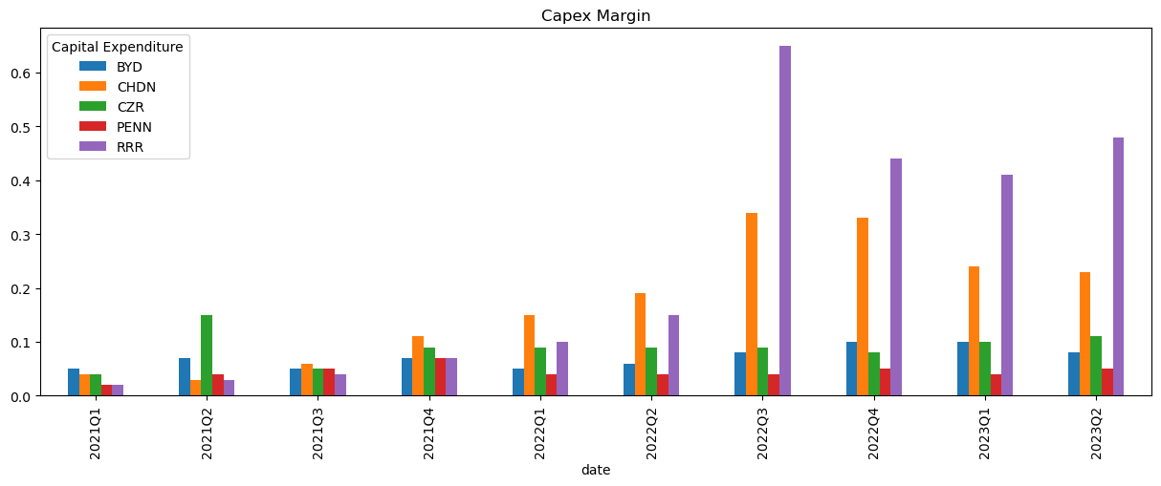
CAPEX Margin (Quarterly)

Slide 16
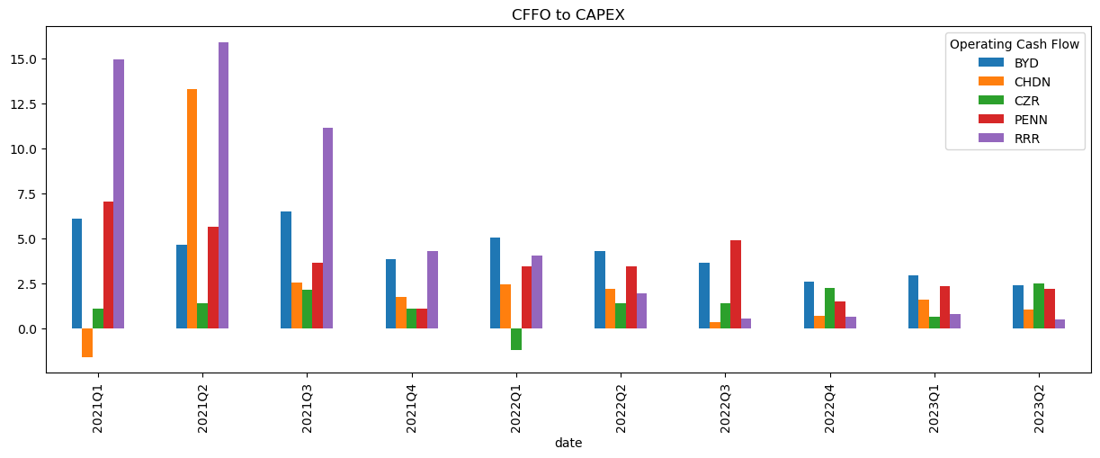
Cash Flow From Ops to CAPEX

Slide 17
Encouraging Signals
F1
The room rates and other factors suggested that there was less excitement or enthusiasm than initially expected.
still expressed optimism about F1, anticipating positive outcomes for their properties from the influx of visitors.
Super Bowl
Allegiant Stadium
Mentioned strong bookings in 3Q Earnings Call and anticipated it to be a positive outlier weekend, expecting robust demand and positive effects on their business during the Super Bowl period.
Should offset the whole left by CONAG (next one is 2026 – every 3 years)
Durango opening Dec 5th

